Slide 1

PT5053
Evidence Based Practice 2
Research Methods and Critical Appraisal
Lucy Metcalfe
l.metcalfe1@londonmet.ac.uk
Senior Lecturer – Physiotherapy Practice

Slide 2
Session Content
Introduction: Lucy Metcalfe
The Module: PT5053
Course Content
Assessment
What is research?

Slide 3
Lucy Metcalfe - Hello
Lecturer: Lucy Metcalfe (Specialist MSK Physiotherapist)
Trained in New Zealand – Auckland University of Technology
Working 3 days at HCA – Shard = speciality in MSK Lower Limb Physiotherapy
Research experience:
Research Assistant: Auckland University of Technology
ML Research Award – Scoping Review
Evidence-based physiotherapist
Contact Me:
l.metcalfe1@londonmet.ac.uk
Working Days: Tuesday and Wednesday

Slide 4
Module Overview
Aim: to develop your ability to understand, interpret, and critically appraise research evidence used in physiotherapy practice.
In this module you will:
Develop an understanding of scientific enquiry and how research evidence is generated
Explore quantitative and qualitative research designs commonly used in healthcare
Learn how data are collected, analysed and interpreted in different types of research
Practice using critical appraisal frameworks to evaluate research quality and trustworthiness
Develop skills to judge whether research findings are appropriate, valid and relevant to practice
Explore how clinical audit and quality assurance contribute to service evaluation
Consider ethical and governance frameworks that underpin clinical research and evaluation

Slide 5
Learning Outcomes
By the end of this module, you will be able to:
Explain the principles of scientific enquiry underpinning different research designs used in evidence‑based clinical practice
Critically evaluate qualitative and quantitative research evidence used in clinical practice and quality assurance
Appraise statistical approaches used in research papers and judge their appropriateness and validity
Demonstrate awareness of ethical, governance and service‑user considerations in clinical research
Formulate appropriate research questions and identify suitable research designs for practice‑based problems

Slide 6
Expectations:
Show up to class and participate
Show up on time
Engage with the class and your peers
Participate in the tutorials

Slide 7
Timetable
Date / Time | Content
04/02/2026 | Introduction to module: EBP
11/02/2026 | Quantitative Research Designs in Health Care
18/02/2026 | Quantitative Data Collection: Measurement, Questionaires and Outcomes
25/02/2026 | Introduction to Quantitative Data Analysis / Interpretation of results
04/03/2026 | Assessment support session for assignement 1: Quantitative
11/03/2026 | No Teaching
18/03/2026 | Critical Appraisal of qualitative research
25/03/2026 | Qualitative Research in Healthcare: Exploring Experience and Meaning
01/04/2026 | Qualitative Data Collection: Interviews, Focus Groups and Observation / Analysing Qualitative Data: From Codes to Themes
08/04/2026 | Introduction to Systematic Reviews
15/04/2026 | Assessment support session for assignment 2: Qualitative
22/04/2026 | No Lectures
Check weblearn for updates

Slide 8
Assessment:
There are two coursework assessments, each worth 50% of the module mark:
Quantitative Research Critical Appraisal:
DUE: Friday 13th March 2026
750‑word written assignment
Critical appraisal of a published quantitative research article
Qualitative Research Critical Appraisal:
DUE: Friday 8th May 2026
750‑word written assignment
Critical appraisal of a published qualitative research article

Slide 9
Assignment
Both assignments focus on your ability to:
Understand research design and methods
Critically evaluate quality and limitations
Interpret findings appropriately
Consider relevance to clinical practice

Slide 10
Critical Appraisal – Quantitative Study
Select ONE article from the two provided for that methodology (quantitative).
Conduct a critical appraisal using the relevant CASP checklist (quantitative).
Use the PT5053 Assignment Template to structure your writing within 750‑words across key components such as study design, sampling, data collection, analysis, findings, strengths/limitations, and relevance to physiotherapy practice.
Use academic writing, integrate methodological principles, and clearly justify all evaluative judgments.

Slide 11
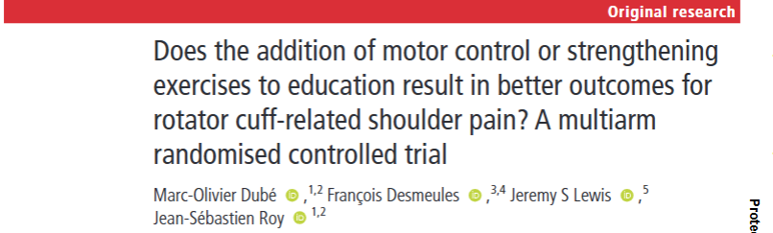
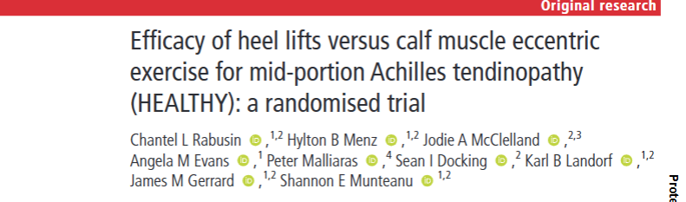
Pick one of the two studies:

Slide 12

Use the CASP

Slide 13
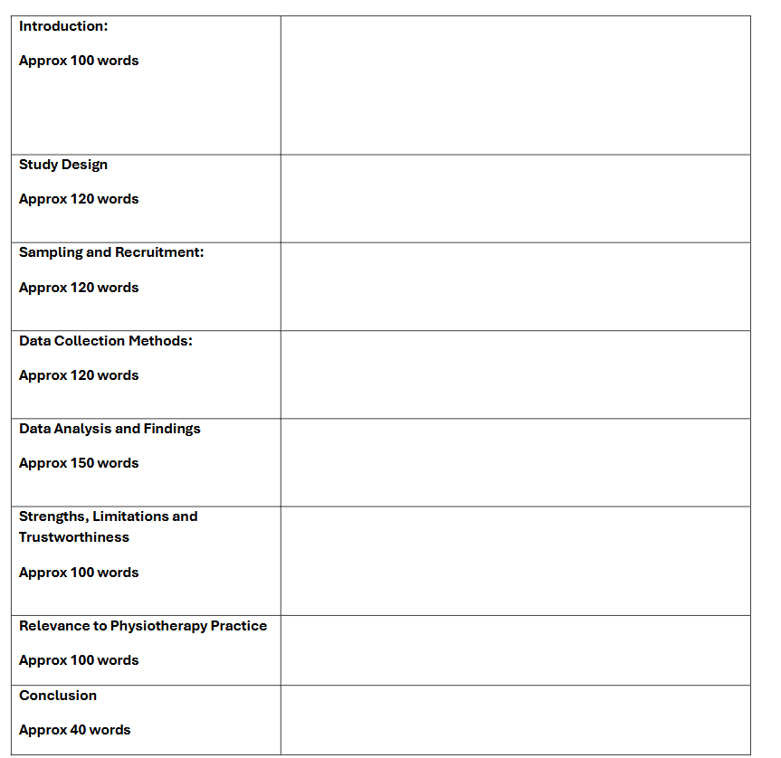
Use the Template

Slide 14
Critical Appraisal – Qualitative Study
You must:
Select ONE article from the two provided for that methodology qualitative
Conduct a critical appraisal using the relevant CASP checklist qualitative
Use the PT5053 Assignment Template to structure your writing within 750‑words across key components such as study design, sampling, data collection, analysis, findings, strengths/limitations, and relevance to physiotherapy practice.
Use academic writing, integrate methodological principles, and clearly justify all evaluative judgments.

Slide 15
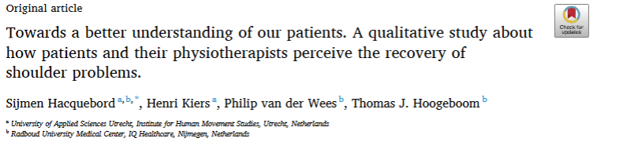

Pick one of the two studies:

Slide 16

Use the CASP

Slide 17
Use the Template

Slide 18

Questions?

Slide 19
What is Research?
Research is what we do when we have a question or a problem we want to resolve
We may already think we know the answer to our question already
We may think the answer is obvious, common sense even
But until we have subjected our problem to rigorous scientific scurrility, our ‘knowledge’ remains little more than guesswork or at best, intuition.

Slide 20
What is Research?
The first priority is to formulate your research question
Then figure out how you are going to answer it
How have others answered it?
How does your proposal fit in with what others have done?
How will you know when you have answered it?
Then you can present your answer

Slide 21
Clinical Research
The ultimate goal of clinical research is to maximise the effectiveness of practice
Clinical research is essential to inform clinical judgement
We MUST exercise a commitment to scientific discovery that will lead to improvements in standards of care and patient outcomes
The importance of engaging in collaborative and interprofessional efforts cannot be over emphasised
(Gross Portney, 2020)

Slide 22
Clinical Research – Three Parts
Patient oriented research: studies conducted with human subjects to improve our understanding of the mechanisms of diseases and disorders, and of what therapeutic intervention will be most effective in treating them
Epidemiological and behavioural studies: Observational studies focused on describing patterns of disease and disability
Outcome research and health service research: studies to determine the impact of research on a population health and utilisation of evidence-based therapeutic interventions
(Gross Portney, 2020)

Slide 23

Qualitative Research
VS
Quantitative Research

Slide 24
Quantitative Research – Assignment 1
Quantifies relationships between two or more variables
Tests a hypothesis
Measures outcomes using numerical data under standardised conditions
Quantitative information may be obtained using formal instruments that address physical, behavioural or physiological parameters or putting subjective information into an objective numerical scale
To measure, count and quantity a problem

Slide 25
Qualitative Research – Assignment 2
Explores issues, underlying reasons, motivations
Identified new concepts and theories
To gain a detailed understanding or explanation of underlying reasons, beliefs and motivations
E.g. why, how, who, when?
In qualitative methodology ‘measurement’ is based on subjective, narrative information which can be observed using
Focus groups
Interviews
Observation
Analysis of narrative data is based on thick description to identify themes
Qualitative research is considered descriptive in that it involves collection of data through interviews and observations

Slide 26
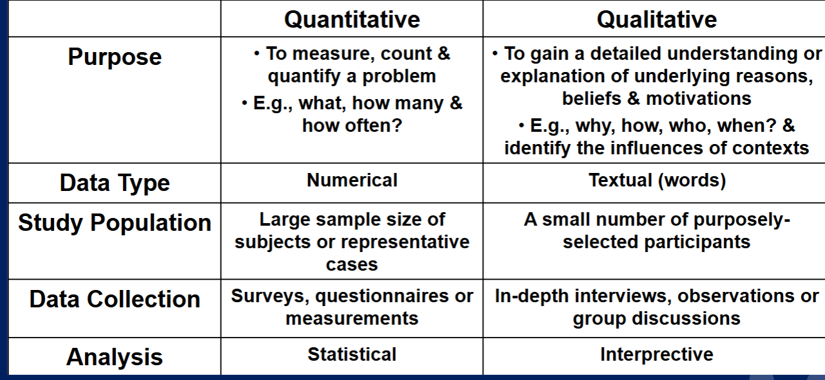

Slide 27
Types of Research
Research can be viewed along a continuum that reflects the type of question the research is intending to answer
The research continuum is not hierarchical – each type of research fulfils a particular purpose and need
Systematic Reviews:
Present a comprehensive analysis of the full range of literature on a particular topic. These studies look at methodological quality of studies to frame the state of knowledge on a topic
Meta-analysis:
Goes a step beyond systematic review, applying a process of statistically combing the findings from several studies to obtain a summary analysis
Scoping Review:
Incorporates a broader range of study designs and data gathering methods to comprehensively synthesise evidence often with the aims of informing policy, practice, programming and providing directions to future research

Slide 28
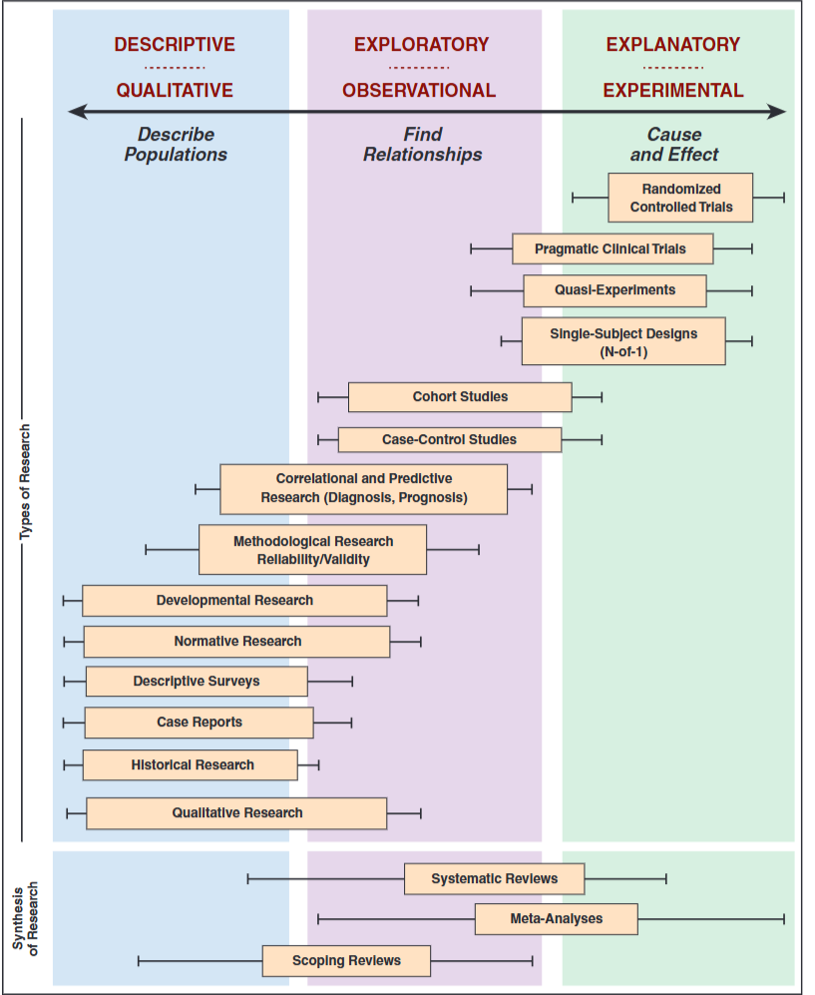

Slide 29
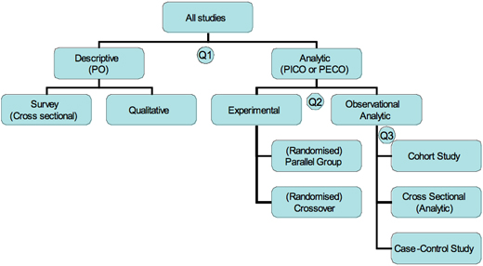

Slide 30
Research Types
Randomised control trial RCT: An efficacy trial involving the controlled comparison of an experimental intervention and a placebo, sham or usual care condition. Through random assignment and restricted subject selection, the design controls for bias to allow cause and effect conclusions.
Pragmatic Clinical Trial: An effectiveness trial with a focus on real world outcomes. Participants represent the patients that would typically receive treatment.
Quasi experimental design: Comparative design that do not have a control group or randomisation. Includes time series design that allows for repeated measurements over prolong periods to document trends

Slide 31
Research Types (Observational)
Cohort studies: Observational studies where one or more cohorts of individuals are followed prospectively to demine their status with respect to a disease or outcome and their exposure to certain risk factors
Case control studies: Observational studies that compare patients with (cases) and without (controls) a disease or outcome of interest. Cases and controls are compared on their exposure to a risk factor to determine the relationship between the risk factor and the disorder
Methodological Studies: Using correlational and comparative methods to demonstrate reliability and validity of measuring instruments, including interpretation of change and responsiveness

Slide 32
Research Types – Descriptive Research
Case report / Case Series: Description of one or several patients or communities to document unusual conditions or the effect of innovated interventions
Qualitative Research: Also called naturalistic research; observations or interviews explore the meaning of human experience as it occurs naturally, generating hypothesis about human behaviour
Mixed Methods Research: A combination of quantitative and qualitative research methods

Slide 33
Evidence-Based Practice (EBP)
The concept of EBP represents the fundamental principle that the provision of quality care will depend on your ability to make choices that are based on the best evidence currently available.
The concept of EBP is more than just reliance on published research, however, make decisions based on available literature, as well as your own clinical judgement an experience
All in the context of a clinical setting and patient experience

Slide 34
Evidence- Based Practice
EBP requires that decisions about health care are based on the best available, current, valid and relevant evidence.
These decisions should be made by those receiving care, informed by the explicit knowledge of those providing care, within the context of available resources
Integration of best research evidence with clinical expertise and patient values
As physiotherapists we have a commitment to use the best available evidence to inform decision making about the care of individuals that involves integrating physiotherapy practices and individual professional judgement with evidence gained through systematic research (Veras, Kairy and Paquet, 2016)
Clinical reasoning and decision making is based on the best available evidence and the integration of professional practice expertise with patient values.

Slide 35
Why is EBP so important?
To underpin and shape how the profession delivers patient care
To promote the value and impact of UK physiotherapy contribution to meeting population and patient needs in a clinically / cost effective way
To inform the development of physiotherapy practice, service delivery and education
To progress the professions approach to developing, using and promoting research and its contribution to generating new evidence, knowledge and service improvement

Slide 36
Chartered Society Physiotherapy Expectations
Members need to critically engage with available and emerging evidence that relates to professional activity and service delivery
Members need to critically appraise their practice in light of available and emerging evidence
Members need to contribute to identifying evidence gaps and priorities for new research

Slide 37
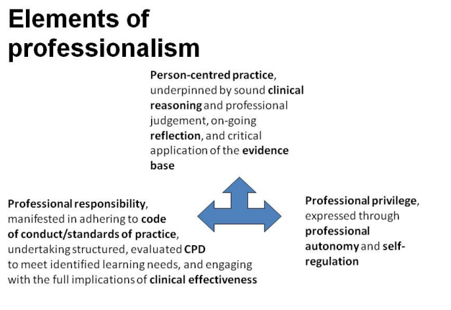

Slide 38
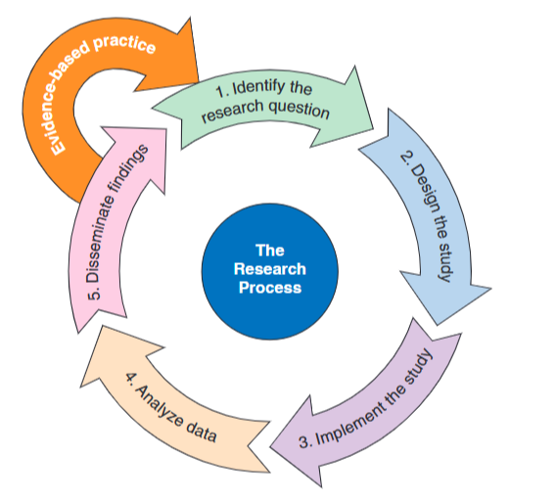
Research Process

Slide 39
Identify the Research Question
Select a topic of interest:
Identify the problem: Clinical experience, Clinical Theory, Professional Literature
Identify the rationale: Research Rationale, Theoretical Framework, Purpose
Identify the type of research: Qualitative OR Quantitative
Define the Research Question: PICO
P: Population: What is the target population or problem of interest?
I: What intervention is being studied?
C: Will you study any comparison variables?
O: What are the outcomes that you will study?

Slide 40
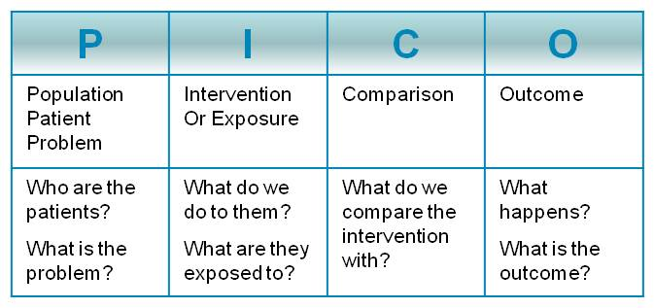

Slide 41
PICO Question
Example: In people with chronic back pain, is spinal manipulation more effective than light massage in reducing pain and functional disability
P: Population: Chronic Back Pain
I: Intervention: Spinal Manipulation
C: Comparison: Light massage
O: Reducing pain and functional disability
Notes:
Population: ACL post operative
Intervention: cyrocuff (ice)
Comparison: cycling
Outcome: Reduce pain (NRPS) and improve knee ROM (active) in first week post op

Slide 42
Task
What are you interest in?
What questions do you have?
How can you use these interests to develop PICO research question?
Find an up-to-date research systematic review or meta-analysis that synthesises the available literature on a particular topic of interest; provides a critical appraisal of prior research and help to summarise the state of knowledge on this topic.

Slide 43
Next Week: 11/02/26
We are going to learn about:
Quantitative Research
Different Types of Quantitative Research (RCT, Case-Control, Cohort, Cross-sectional)
3. Bias, cofounding, internal and internal validity
We are going to practice:
1. Using the CASP tool to critique the first six questions of a quantitative research article

Slide 44
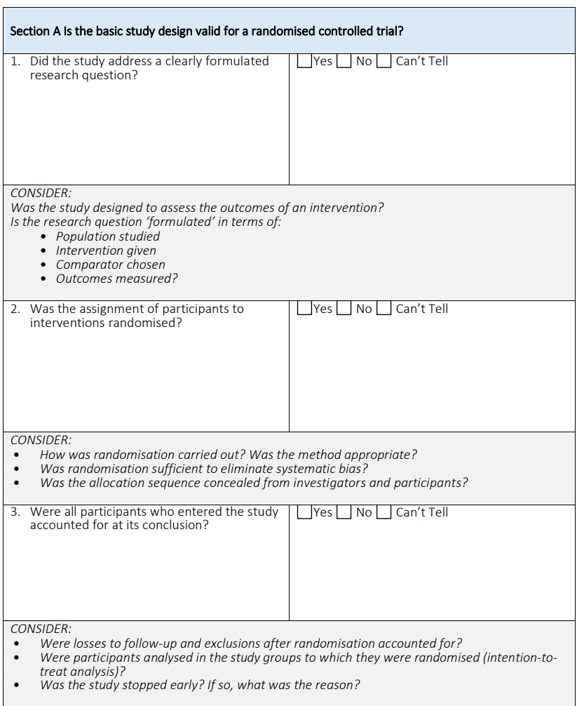

Slide 45
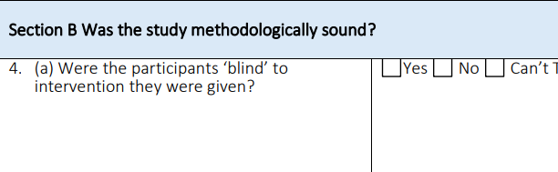
Methods

Slide 46
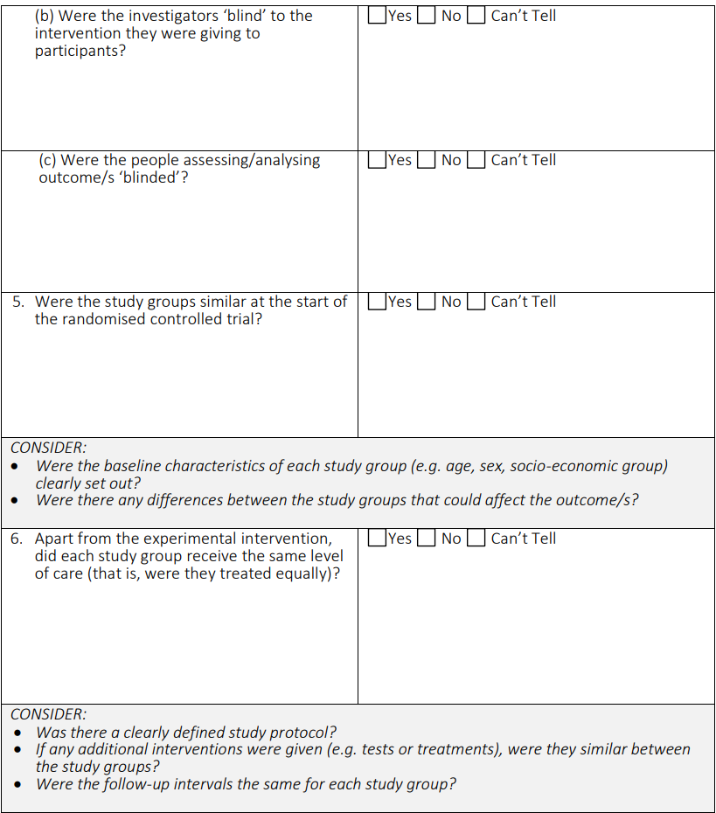

Slide 47
References
Hoffmann, T., Bennett, S. and Mar, C.D. (2017). Evidence-based practice across the health professions. 3rd ed. Elsevier.
Portney, L.G. (2020). Foundations of clinical research: Applications to practice. 4th ed. Philadelphia: F.A. Davis Company.
Veras, M., Kairy, D. and Paquet, N. (2016). What Is Evidence-Based Physiotherapy? Physiotherapy Canada, [online] 68(2), pp.95–96. doi:https://doi.org/10.3138/ptc.68.2.gee.

